Slide 1
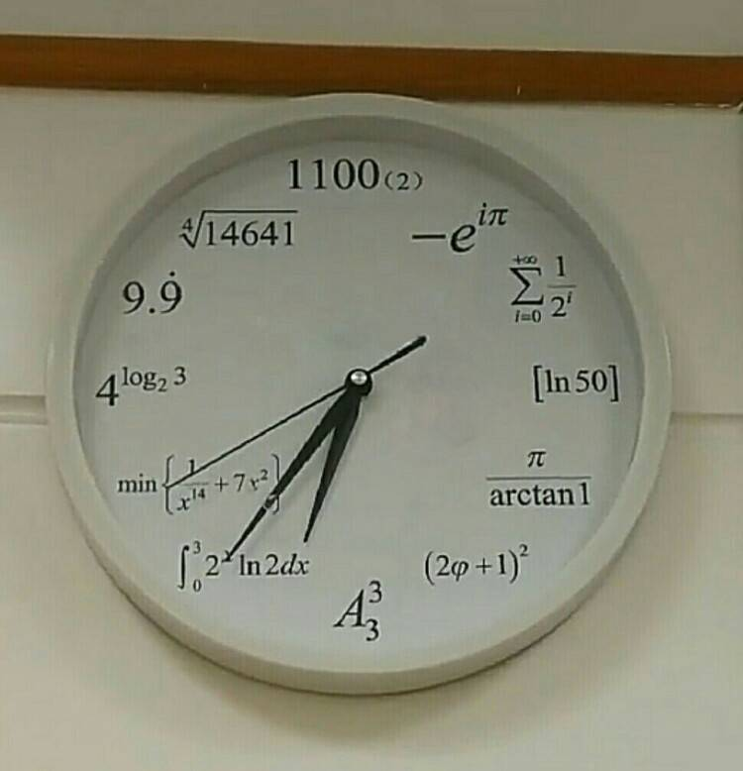
Chronic lateness is Serious
Feng Zhuo

Slide 2
Motivating Research issue
The motivating research issue is what is the real reason behind chronic lateness.
“Chronic lateness is already a pattern of behavior, which is why chronically late people may not realize that they are not late because some accident happens, but because having a habit of being late, and “accident” and “emergency” happens to them all the time. People who are chronically late obviously have organizing issues, pointing out what’s behind that is one of the purposes of this research.”

Slide 3
Mature guesses of the cause of chronic lateness
Family ( Unpunctual Parents )
Don’t care about the consequence
Break the rules
Internal clock
Low self-esteem
Psychological buffer (Subconsciously)

Slide 4
Background Info
Family issue:
Merrill.P.Q., (2009). Long-term Effects of Parents’ Education on Children’s Educational and Occupational Success: Mediation by Family Interactions, Child Aggression, and Teenage Aspirations:
“Participants were reinter viewed at ages 19, 30, and 48 (Eron et al, 1971; Huesmann et al., 2002). Parents’ educational level when the child was 8 years old significantly predicted educational and occupational success for the child 40 years later.”
“

Slide 5
Background Info
Effective solution:
Bataineh.M, (2014). A review of Factors Associated with Student's Lateness Behavior and Dealing Strategies:
“On the other hand, college may invite the students to discuss and seek explanation for their unsatisfactory attendance to be improved and any support that may be required. One more things, educational institutions should developed a firm, well- established policy that handling late students, and should imposition of sanctions and penalties for late students."

Slide 6
How do you know if you had this issue?
Step 1: Make a form, and record everything you do for a week.
Step 2: Admit it.

Slide 7
Proposal
Step 1: Take it seriously (A sign of emotional detachment).
Step 2: Knowing it takes time to fix the issue.
Step 3: Try new things.

